Slide 1
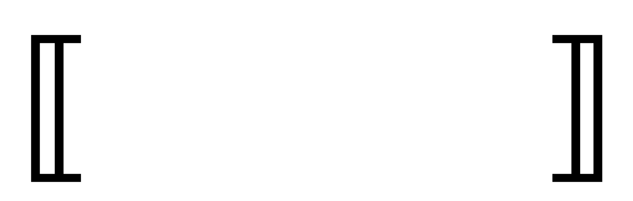
Deriving induction principles using parametricity
Tomas Vallejos
CC7125

Slide 2

Roadmap
Induction principles.
Parametricity translation.
Derive induction principles using the parametricity translation.
Challenges.

Slide 3

Logic
Study of correct reasoning.
Proof assistants.
Reasoning with inductive types.

Slide 4

Induction principles
Proving a certain property holds.
Based on the structure.

Slide 5

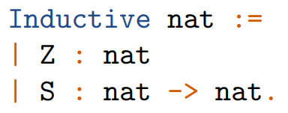
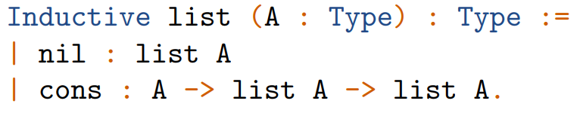
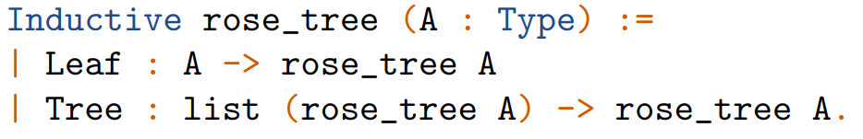
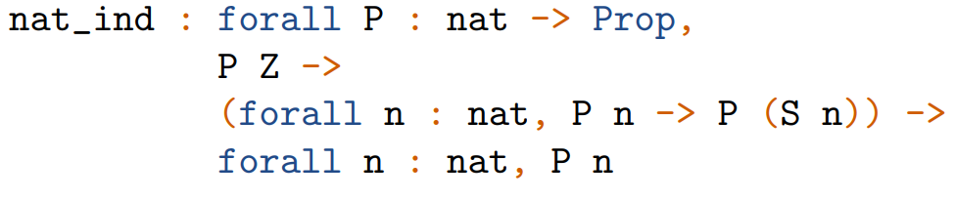
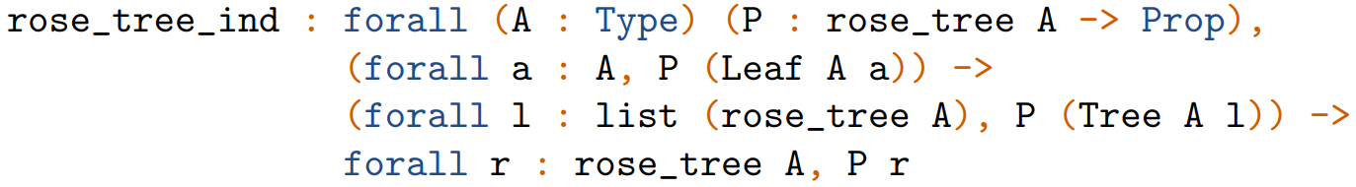
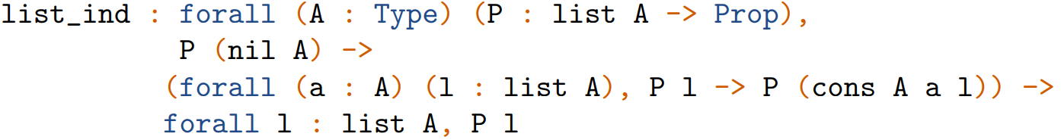
Coq Induction Principles Generator
Coq generates induction principles automatically.

Slide 6
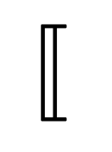

Parametricity translation
t
A translation from types to relations.
$Γ⊢A :B→⟦Γ⟧⊢⟦A⟧ :⟦B⟧ \overline{A}$
  $⊢A :B→ ⊢⟦A⟧ :⟦B⟧ \overline{A}$
    $⊢A :B→ ⊢⟦A⟧ :⟦B⟧ A$

Slide 7
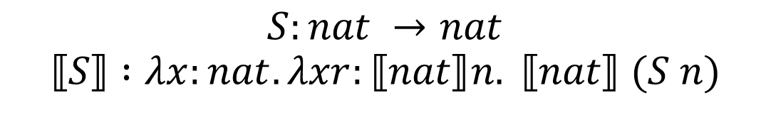
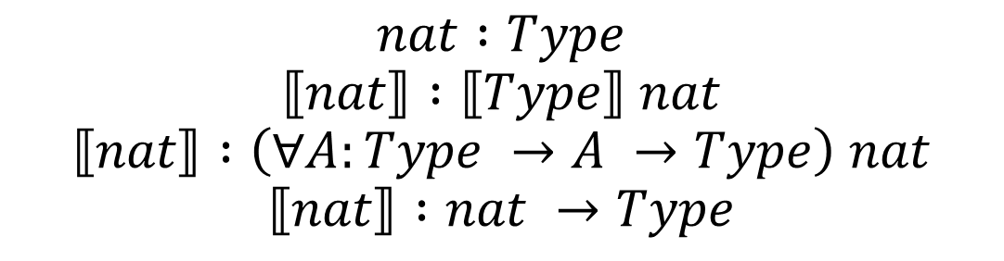

Deriving induction principles using parametricity
$$nat :Type$$
$$⟦nat⟧ :⟦Type⟧ nat$$
$$⟦nat⟧ :\left(∀A:Type →A →Type\right) nat$$
$$⟦nat⟧ :nat →Type$$
$$Z:nat$$
$$⟦Z⟧ :⟦nat⟧ Z$$
$$S:nat →nat$$
$$⟦S⟧ :λx:nat. λxr:⟦nat⟧n. ⟦nat⟧ (S n)$$

Slide 8
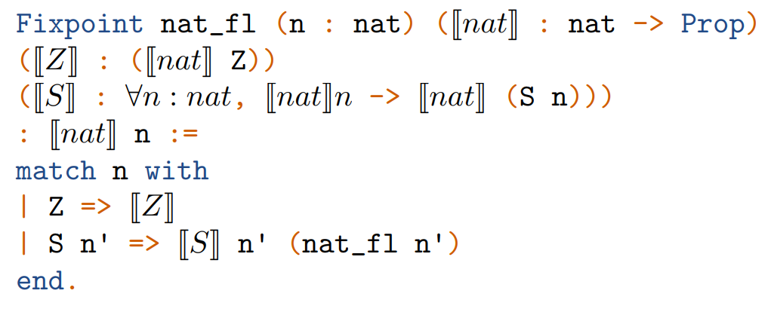
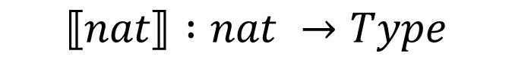
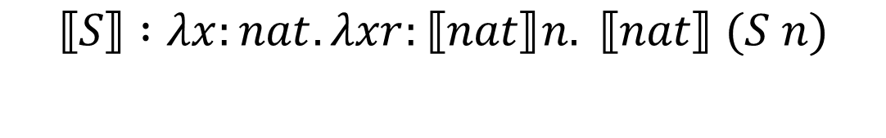
Deriving induction principles using parametricity
$$⟦nat⟧ :nat →Type$$
$$⟦Z⟧ :⟦nat⟧ Z$$
$$⟦S⟧ :λx:nat. λxr:⟦nat⟧n. ⟦nat⟧ (S n)$$

Slide 9
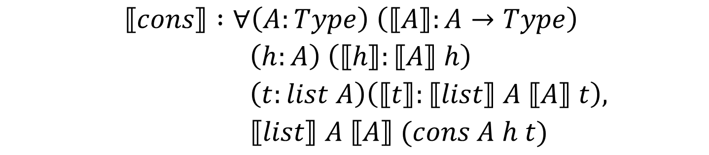
Deriving induction principles using parametricity
$$⟦list⟧ :∀A:Type, \left(A →Type\right)→list →Type$$
$$⟦nil⟧ :∀\left(A:Type\right) \left(⟦A⟧ :A →Type\right), ⟦list⟧ A ⟦A⟧ nil$$
$$⟦cons⟧ :∀\left(A:Type\right) \left(⟦A⟧:A→Type\right)$$
$\left(h:A\right) \left(⟦h⟧:⟦A⟧ h\right)$
$\left(t:list A\right)\left(⟦t⟧:⟦list⟧ A ⟦A⟧ t\right),$
$⟦list⟧ A ⟦A⟧ (cons A h t)$

Slide 10
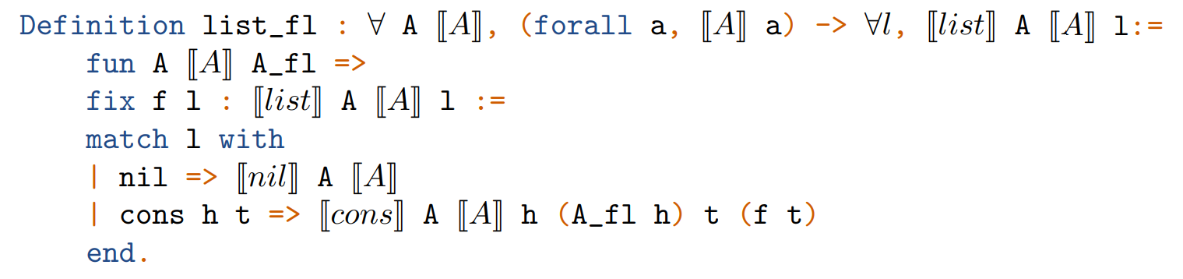
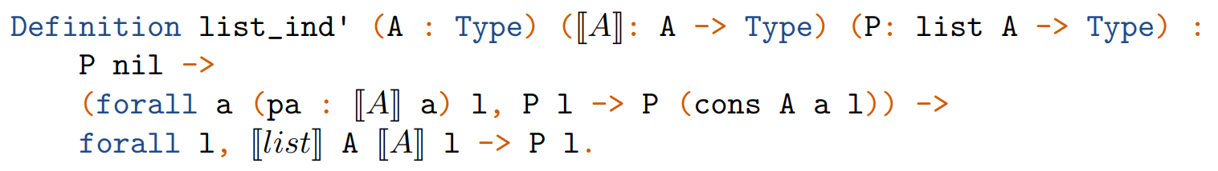

Deriving induction principles using parametricity
$$⟦list⟧ :∀A:Type, \left(A →Type\right)→list →Type$$
$$⟦nil⟧ :∀\left(A:Type\right) \left(⟦A⟧ :A →Type\right), ⟦list⟧ A ⟦A⟧ nil$$
$$⟦cons⟧ :∀\left(A:Type\right) \left(⟦A⟧:A→Type\right) \left(h:A\right) \left(⟦h⟧:⟦A⟧ h\right)$$
$\left(t:list A\right)\left(⟦t⟧:⟦list⟧ A ⟦A⟧ t\right), ⟦list⟧ A ⟦A⟧ (cons A h t)$

Slide 11
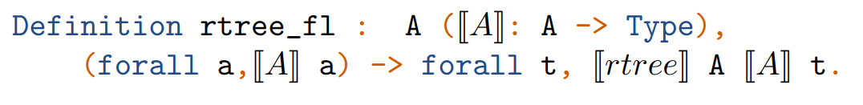
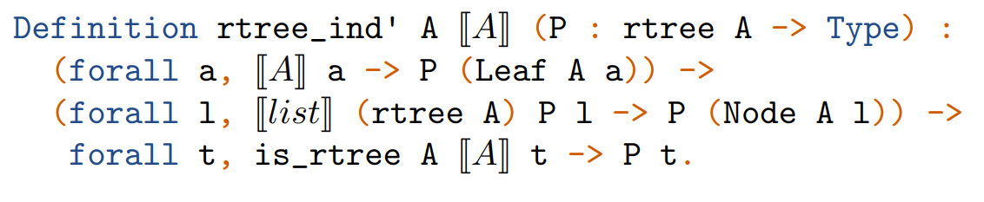
Deriving induction principles using parametricity
$$⟦rtree⟧ :∀A:Type, \left(A →Type\right)→rtree A→Type$$
$$⟦Leaf⟧ :∀\left(A:Type\right) \left(⟦A⟧ :A →Type\right) \left(a :A\right) (⟦a⟧ :⟦A⟧ a), ⟦rtree⟧ A ⟦A⟧ (Leaf A a)$$
$$⟦Tree⟧ :∀\left(A:Type\right) \left(⟦A⟧:A→Type\right)$$
$\left(l:list (rtree A\right)) \left(⟦l⟧:⟦list⟧ \left(⟦rtree⟧ A ⟦A⟧\right) l\right),⟦rtree⟧ A ⟦A⟧ (Tree A l)$

Slide 12
References
[1]: Jean-Philippe Bernardy, Patrik Jansson, Ross Paterson: Parametricity and dependent types. ICFP 2010: 345-356
[2]: Enrico Tassi: Deriving Proved Equality Tests in Coq-Elpi: Stronger Induction Principles for Containers in Coq. ITP 2019: 29:1-29:18

Slide 13
Deriving induction principles using parametricity
Tomas Vallejos
CC7125

